Slide 1
Financial Data Structures
Jiaxuan Felix Li

Slide 2
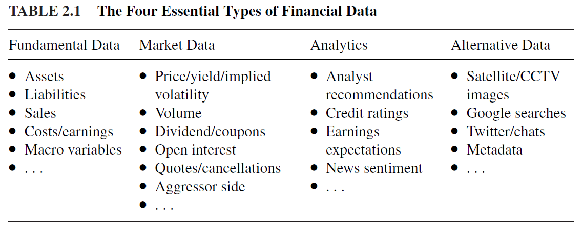
Motivation
How to work with unstructured financial data
Derive a structured dataset amenable to ML algorithms.
Four essential types

Slide 3
Type 1: Fundamental Data
Fundamental data encompasses information that can be found in regulatory filings and business analytics
Assets
Liabilities
Sales
Costs/earnings
Macro variables

Slide 4
Two issues in Fundamental Data
Data reported with a lapse
You must confirm exactly when each data point was released
E.g. fundamental data published by Bloomberg is indexed by the last date included in the report, which precedes the date of the release (often by 1.5). Bloomberg is assigning those values to a date when they were not known.
Data is often backfilled or reinstated.
Backfilling means that missing data is assigned a value, even if those values were unknown at that time.
A reinstated value is a corrected value that amends an incorrect initial release. A company may issue multiple corrections for a past quarter’s results long after the first publication, and data vendors m\ay overwrite the initial values with their corrections. The problem is, the corrected were not known on that first release date. Some data vendors circumvent this problem by storing multiple release dates and values for each variable.

Slide 5
Type 2: Market Data
Market data includes all trading activity that take place in an exchange or trading venue. Ideally, your data provider has given you a raw feed, with all sorts of unstructured information, FIX(Financial Information exchange) messages that allow you to fully reconstruct the trading book, or the full collection of BWIC (bids wanted in competition) responses. Every market participant leaves a characteristic footprint in the trading record, and with enough patience, you will find a way to anticipate a competitor’s next move.

Slide 6
Type 3: Analytics
You could think of analytic as derivative data, based on an original source, which could be fundamental, market, alternative, or enven a collection of other analytics.
A positive aspect of analytics is that the signal has been extracted for you from a raw source. The negative aspects are that analytics may be costly, the methodology used in their production may be biased or opaque, and you will not be the sole consumer.

Slide 7
Type 4. Alternative Data
Individuals: Social media, news, web search
Business process: Transactions, corporate data, government agencies
Sensors: Satellites, geolocation, weather, CCTV

Slide 8
Bars
In order to apply ML algorithms on your unstructured data, we need to parse it, extract valuable information from it, and store those extractions in a regularized format. Most ML algorithm assume a table representation of extracted data. Finance practitioners often refer to those tables’ rows as “bars”. We can distinguish between two categories of bar methods: (1) standard bar methods, which are common in the literature, and (2) more advanced, information-driven methods, which sophisticated practitioners use although they cannot be found (yet) in journal articles.

Slide 9
Standard Bars
Time bars:
Time are obtained by sampling information at fixed time intervals, e.g., once every minute. The information collected usually includes:
Timestamp
Volume-weighted average price (VWAP)
Open price
Close price
High price
Low price
Volume traded, etc
Although time bars are perhaps the most popular amount practitioners and academics, they should be avoided for two reasons.
First, market do not process information at the constant time interval. E.g. The hour following the open is much more active than the hour around noon. This means that time bars oversample information during low-activity periods and undersample information during high-activity periods.
Second, time-sampled series often exhibit poor statistical properties, like serial correlation, heteroscedasticity, and non-normality of returns.

Slide 10
Standard Bars cont
Tick Bars: are a data processing method used in financial market analysis, primarly for sampling and analysis of time series data. In financial markets, trades occur in the form of “ticks,” with each “tick” representing a price change resulting from a trade, regardless of the time interval.
The fundamental concept behind tick bars is to create time intervals based on a certain number of trades (ticks), rather than fixed time intervals. For instance, you can set up a new tick bar for every 1000 trades. This approach ensures that each tick bar contains an equal number of trades, providing a more consistent data sample when dealing with market volatility.

Slide 11
Standard Bars cont
One problem with tick bars is that order fragmentation introduces some arbitrariness in the number of ticks.
Volume bars circumvent that problem by sampling every time a pre-defined amount of the security’s units (shares, futures contract, etc) have been exchanged. For example, we could sample prices every time a future contract exchanges 1000 units, regardless of the number of ticks involved.

Slide 12
Standard Bars cont
Dollar bars: are formed by sampling an observation every time a pre-defined market value is exchanged. Of course, the reference to dollars is meant to apply to the currentcy in which the security is denominated, but nobody refers to euro bars, pound bars, or yen bars (although gold bars would make for fun pun).
An argument that make dollar bars more interesting than time, tick, or volume bars is that the number of outstanding shares often changes multiple times over the course of a security’s life, as a result of corporate actions.
See code: https://github.com/JiaxuanFelixLiTrading/AI-in-Finance/blob/main/bars.ipynb

Slide 13
Standard Bars cont
Information-Driven bars: The purpose of information driven bars is to sample more frequently when new information arrives to the market. In this context, the word “information” is used in a market microstructural sense.

